Slide 1

pySpark on Ubuntu: Experiences
Kang Xu
Nov 9, 2017

Slide 2
Pros and Cons
Pros:
Easy to install and setup, easier than Hadoop. (Please find install guide on handsomeRobot@github.com)
Enable the integration of Python script. Only very limited modifications are required for Python scripts before feed to Spark cluster.
No more manual job-assignments, convenient and safe.
Not slow, sometimes faster than without.
Cons:
Without third-party file manage system, user has to copy the same infile into and collect outfile parts from each node.
pySpark takes additional resources, i.e, 1 core from the master machine and 7% RAM from each node.
RAM limitations on the driver side could lead to break down, i.e, 2G limitation for shuffling.
If one application is running and occupying all the resources, another application has to wait in the queue until the previous one returns unneeded resources.

Slide 3
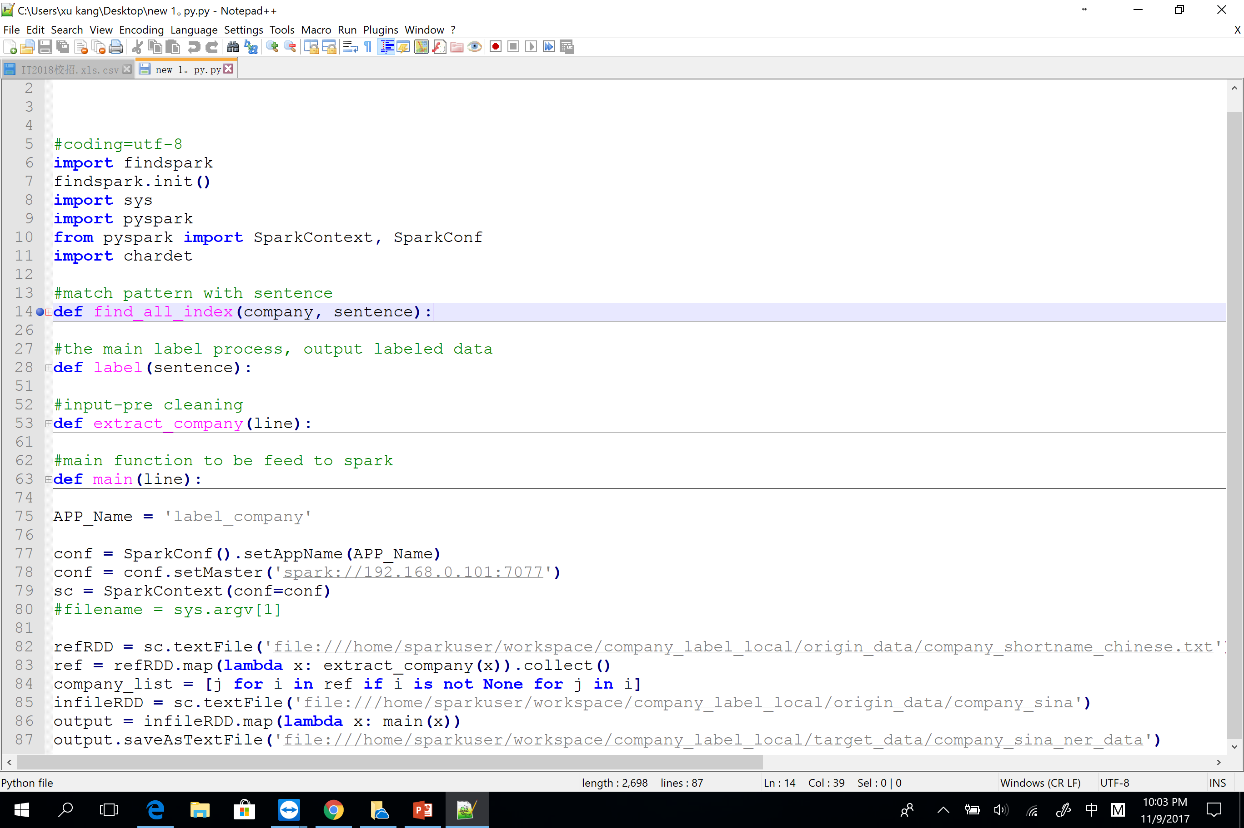
Example on Data Labeling
Input file is divided into small partitions (nested inside RDD) and distributed to all the nodes.
The label function is called from the map() function on each line of RDD.
Spark is lazy, nothing happens until a call of action, i.e, collect(), saveAsTextFile()…

Slide 4
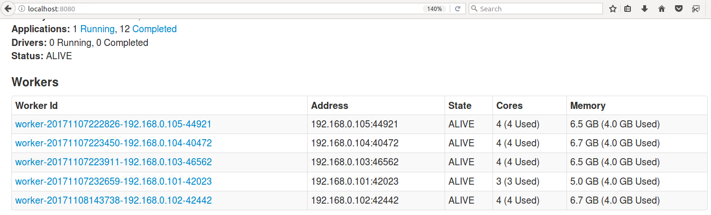
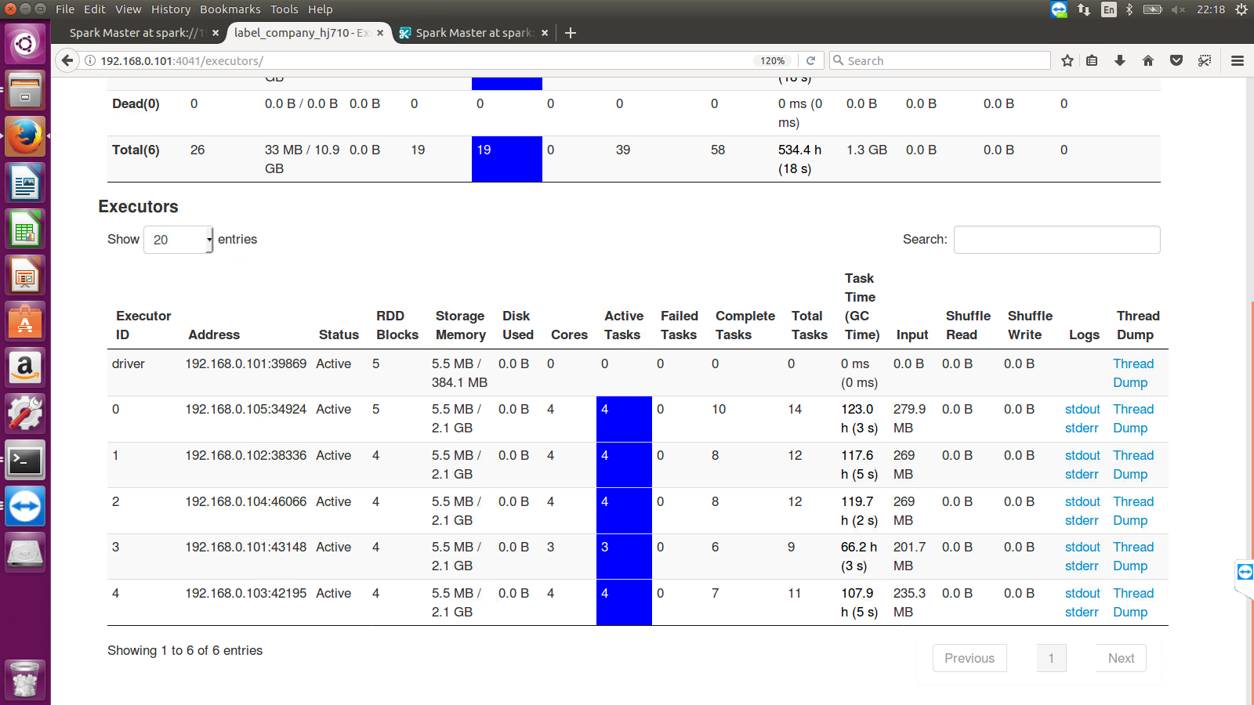
Spark WebUI

Slide 5
Resource Allocations
By default, Spark grabs all but 1G RAM (for system) from each node. For example, Spark takes 7.5G – 1G = 6.5G from salve05.
Among the max of 6.5G, 7% is needed for the maintenance of Spark framework. So left = 6.5G * 93% ~ 6G.
By default, each executor is granted 1G RAM. But recommended by Cloudera engineer, 1 executor = 5 cores. Since in our case, each node has 4 cores, that is 1 node = 4 cores = 1 executor. So 1 executor = 6G (actually only 4G is enough). The memory of executor can be configured in the /opt/spark/conf/spark-env.sh file on the master machine like following: SPARK_EXECUTOR_MEMORY=4g
Or you can increase the number of executors with smaller memory like this:SPARK_EXECUTOR_MEMORY=2g SPARK_EXECUTOR_INSTANCES=3
Changes in the configurations can only take effect once another application is fired and influence only newly-added executors.
Dynamic allocation could be enabled by adding the following line into the /opt/spark/conf/spark-defauts.conf spark_dynamicAllocation_enabled true and adding the following line into each worker node spark_shuffle_service_enabled true.
More optimization tricks
(https://blog.cloudera.com/blog/2015/03/how-to-tune-your-apache-spark-jobs-part-1/)
(https://blog.cloudera.com/blog/2015/03/how-to-tune-your-apache-spark-jobs-part-2/)

Slide 6
Confusing Traps
MUST copy the same infile into the SAME directory on each node. But if you have HDFS or AW3, etc, it does not matter.
The path of input/output file should begin with ‘file://…….’, for example, ‘file:///home/sparkuser/workspace/baidu_company_sina_result.txt’
Be aware of the coalesce() function, if you call an action after coalesce(1), then all the following tasks are performed only on exactly one machine.
The output files are scattered among the nodes, do not miss anyone of them.

